Slide 1
Village Meeting 6th Feb 2026
Jon Fowler - Drayton Parish Council

Slide 2
Agenda
How did we get here
Current Status
Pavilion Options
Your Opinion
Questions

Slide 3
How did we get here
Neighbourhood Plan
  Adopted (Made) September 2015
  Valid until 2031
  Forms part of Vale of White Horse’s Local Plan
  Site known as Walnut Meadows identified for Sports Facilities (2.5 hectares)
  Sports Needs Survey undertaken as part of Neighbourhood Plan
  Updated Survey undertaken 2022
Planning Permission obtained 2017
Public Works Loan application completed 2017

Slide 4
How did we get here

Slide 5
How did we get here
Buried Waste
  Waste buried Nov 2019
  Removed (or not) late 2023

Slide 6
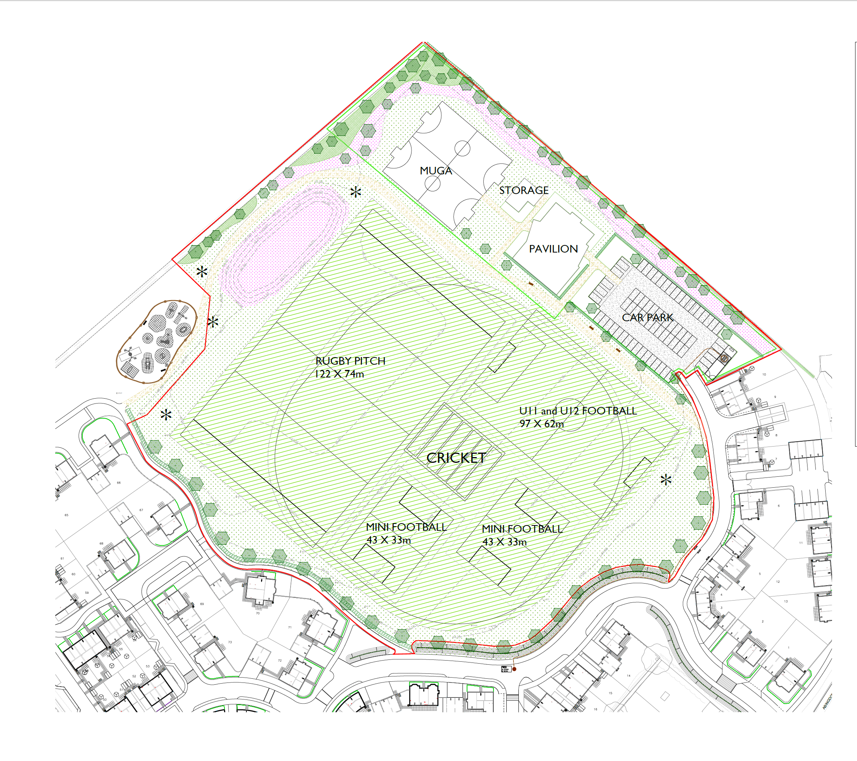

Slide 7
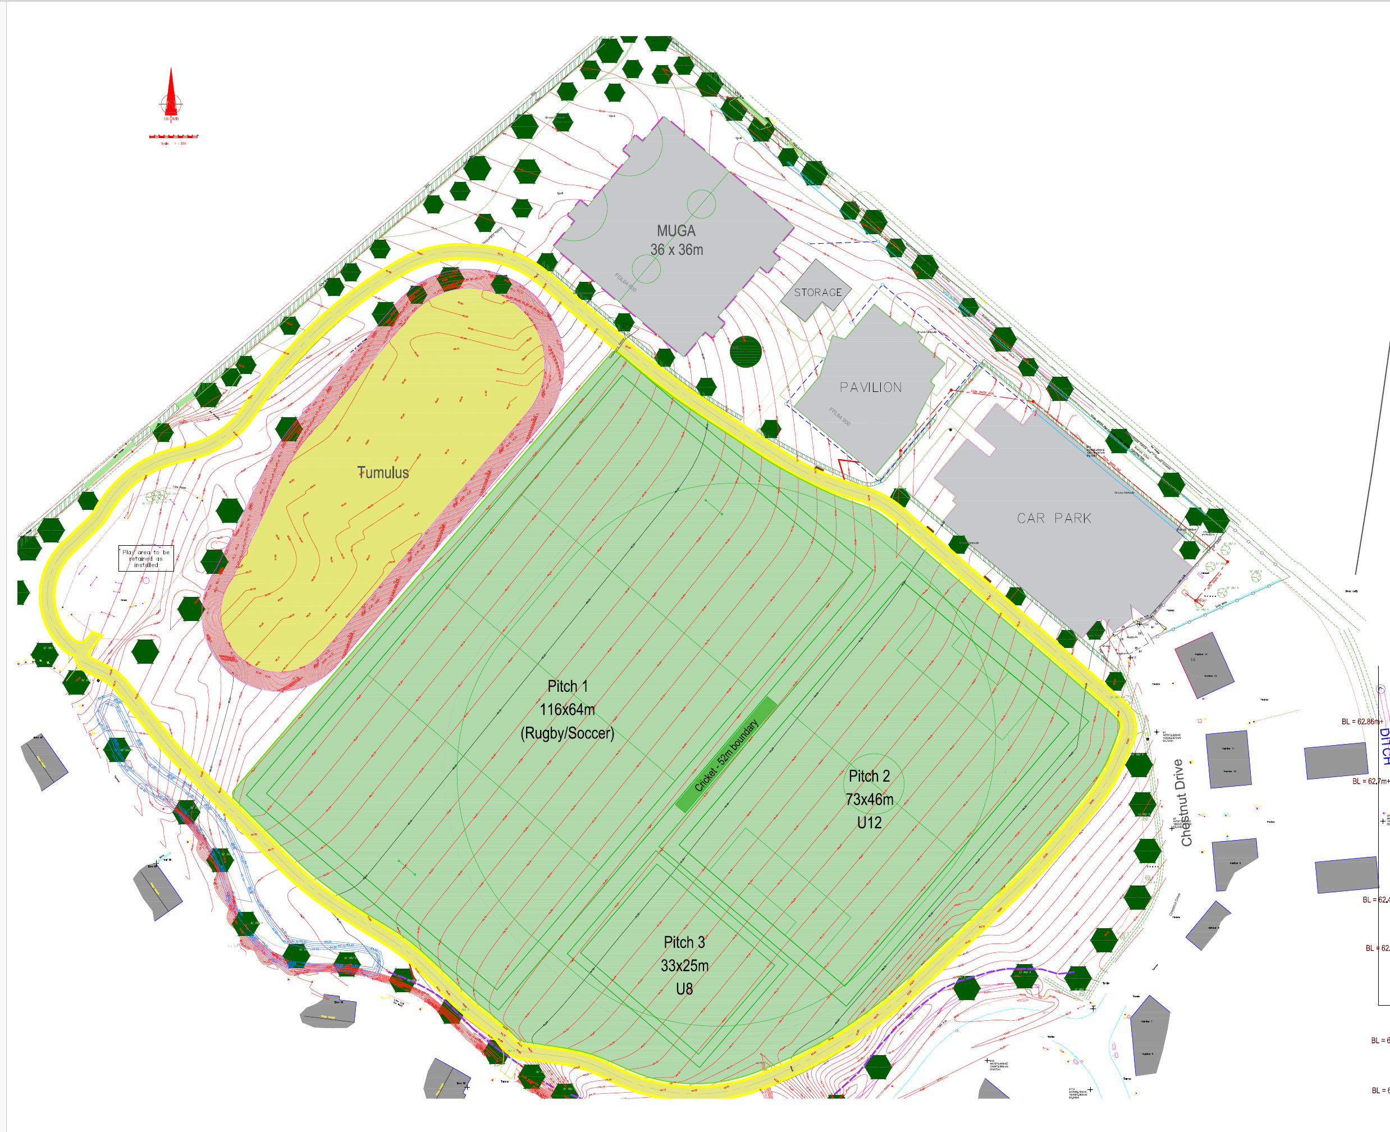

Slide 8
How did we get here
Buried Waste
Barrow Demolition
Inflation
War in Ukraine
Covid
£

Slide 9
Current Status
Multi-Use Games Area (MUGA)
  2 18M x 36M completed
  Tennis, Netball, 5-a-Side, Basketball
  Ready for Use Next Few Weeks

Slide 10
Current Status
Sports Pitches
  Drainage Installed
  Pitch Area Seeded
  Requires one full growing season before use
  Perimeter Path to be completed

Slide 11
Pavilion Options
Pavilion Users
  Drayton Table Tennis Club – Weekday evenings
  Abingdon Youth Football – Weekend & Weekday evenings
  Steventon Cricket Club – TBD
  Kingston Colts Football – TBD
  Drayton Youth Football – Weekday evenings
  Europa Titans Football – Saturday mornings
  Damascus Youth - Weekdays

Slide 12
Pavilion Options
Option A – Planning Permission
  152sq M Main Hall (with divider)
  Kitchen / Bar Area
  Office / Meeting Area
  2 x Changing / Showers
  Separate Referee / First Aid Area
  Externally Accessible Toilet
  Storage

Slide 13
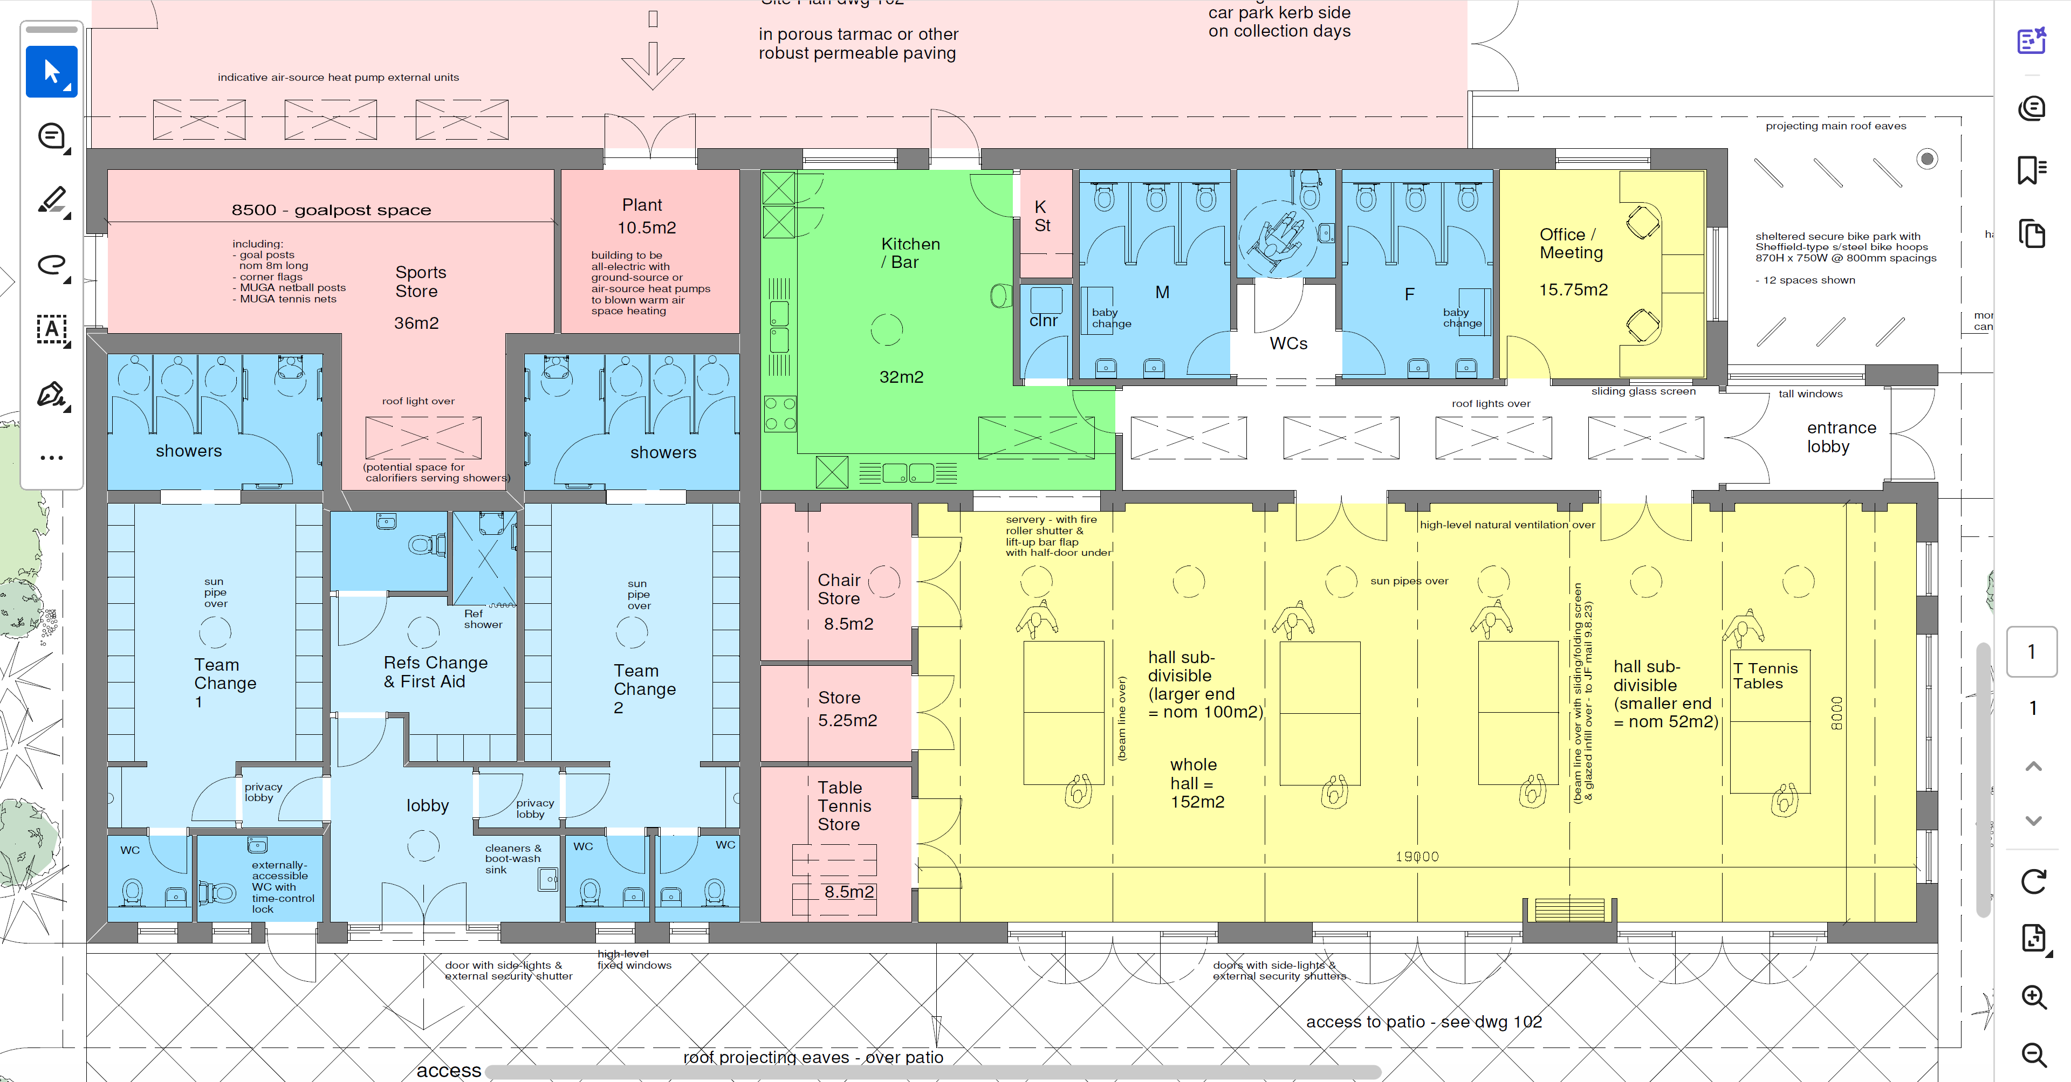
Pavilion Option A

Slide 14
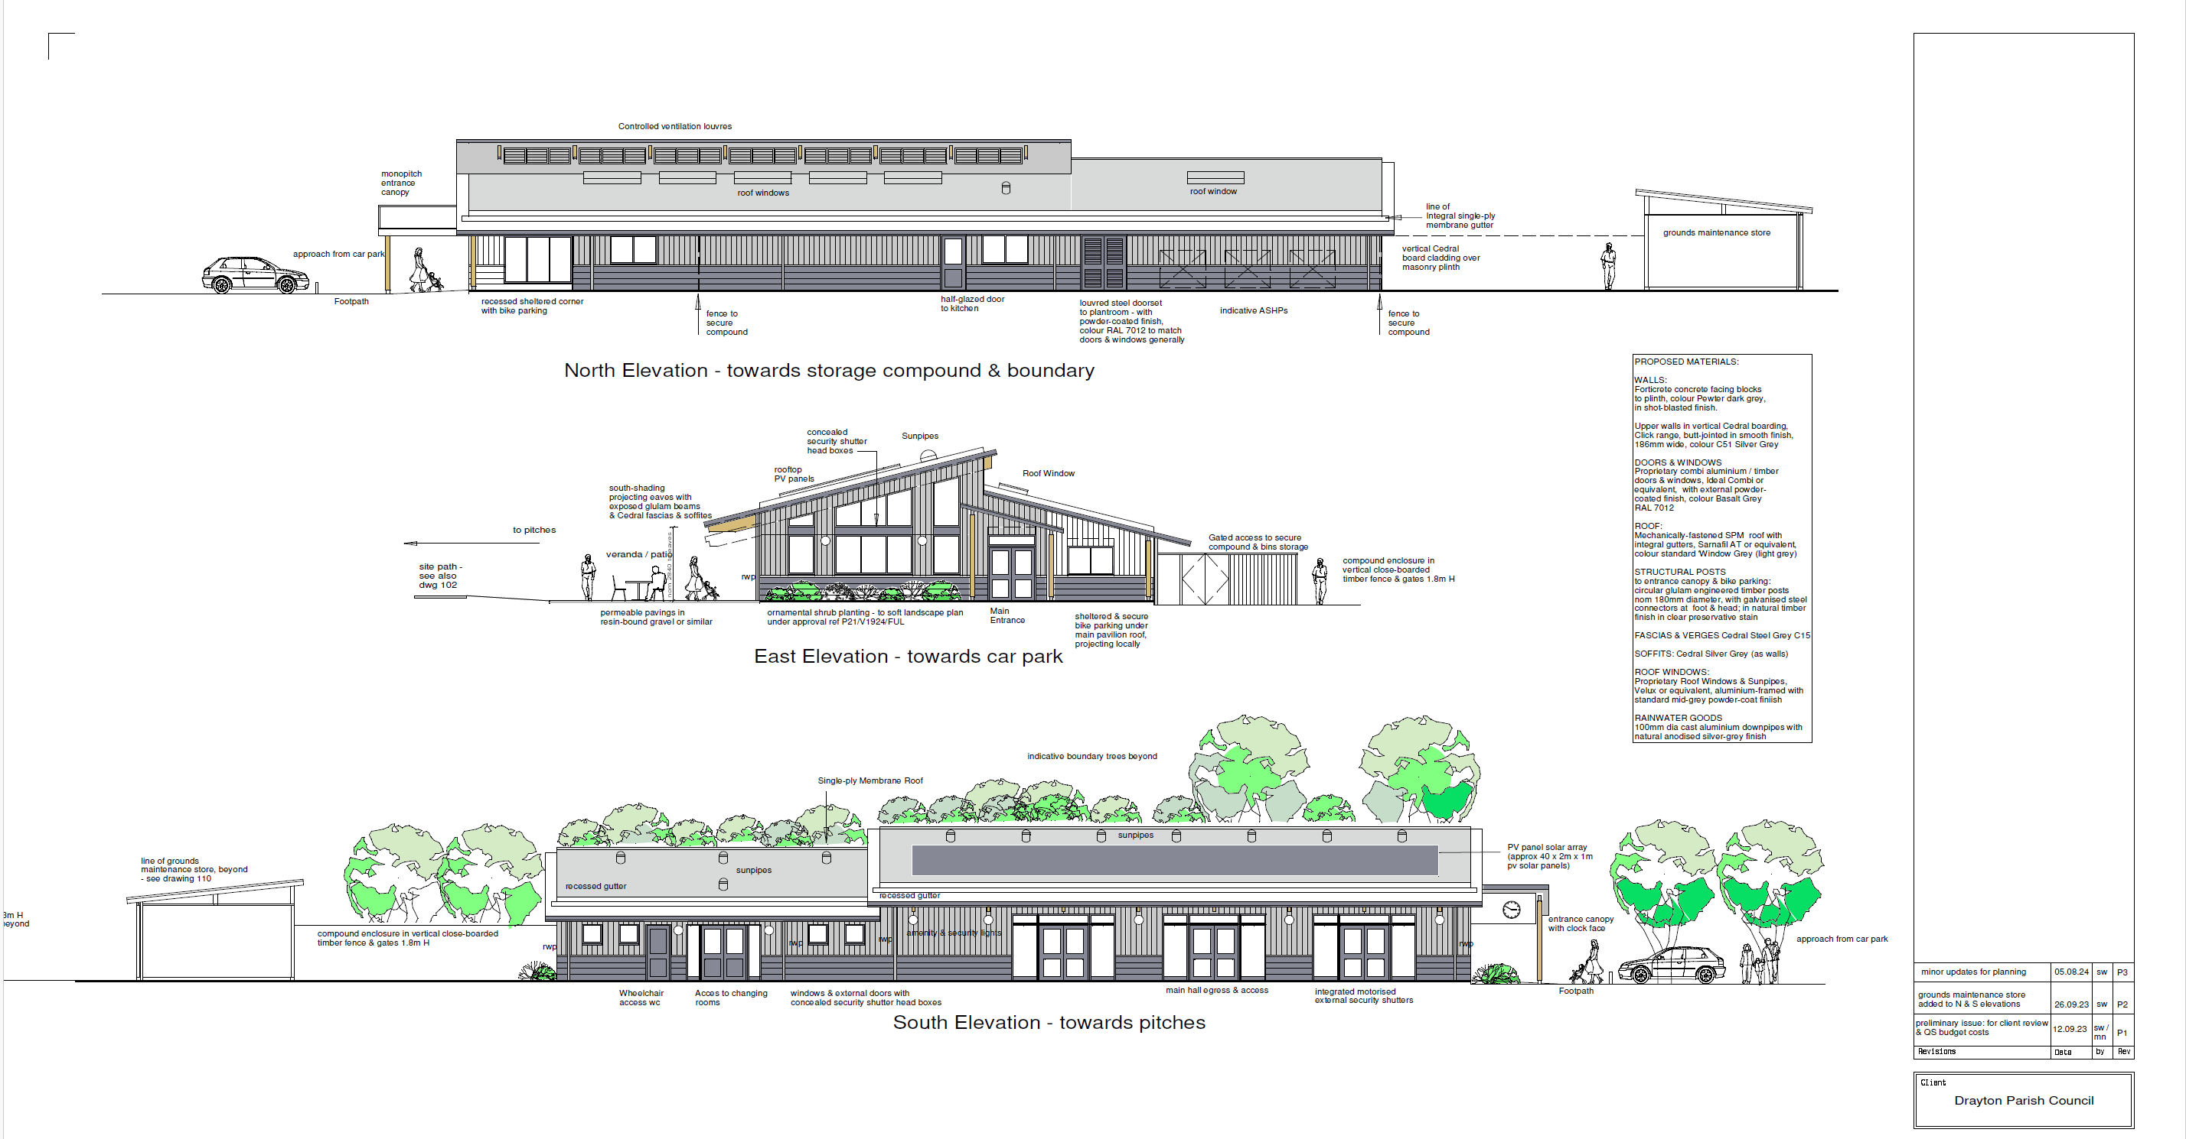
Pavilion Option A

Slide 15
Pavilion Option B
Option 2
  Reduced size main hall (110 sq M)
  Reduced Storage Area
  Reduced Office / Meeting Space
  Reduced Toilet Area
  Loss of Table Tennis (reduced income)
  Changing / Showers – no change

Slide 16
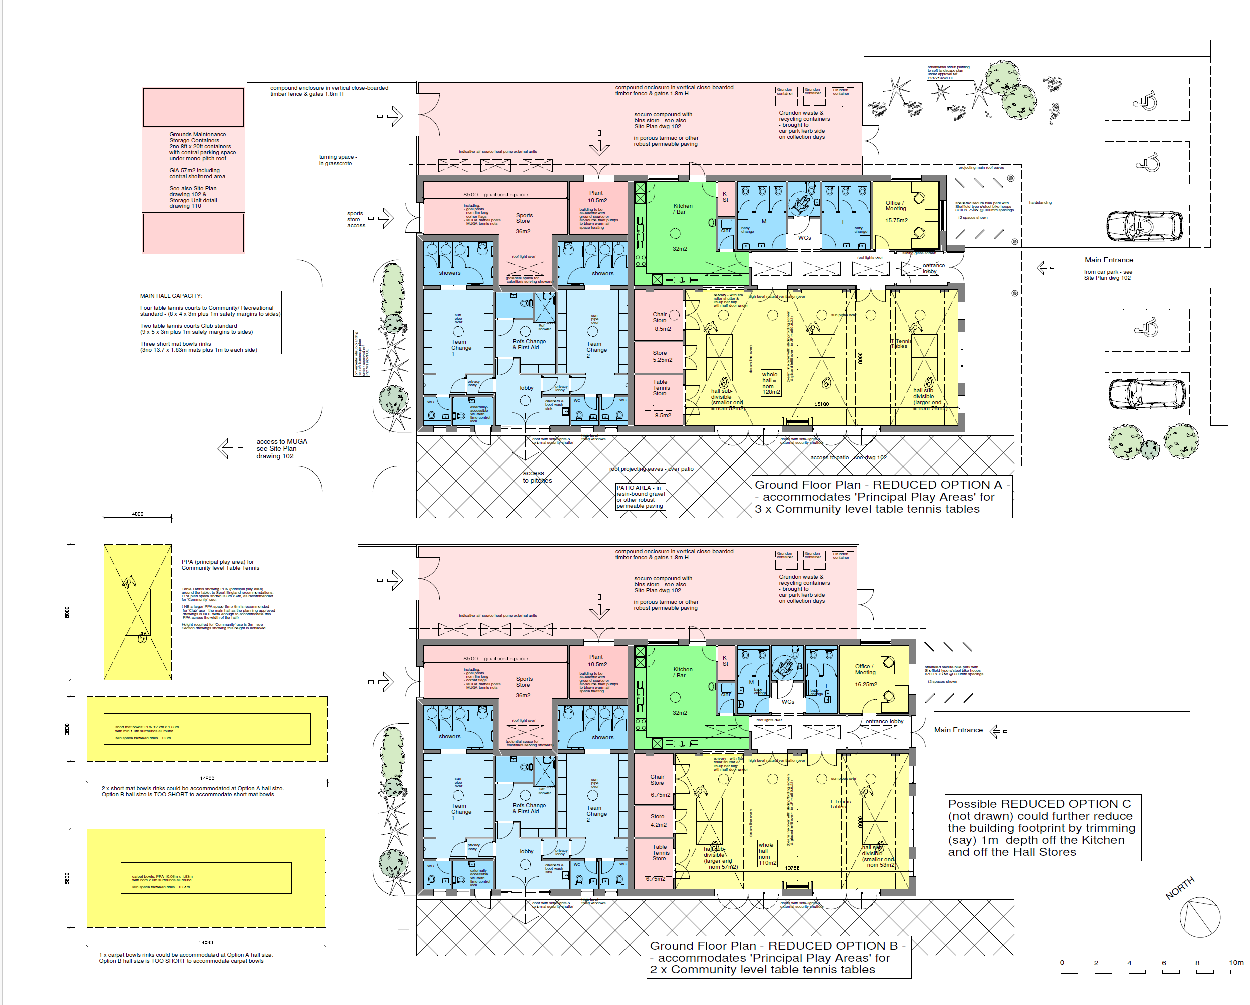
Pavilion Option B

Slide 17
Pavilion Option C

Slide 18
Pavilion Options
Option A | Option B (Reduced Sized) | Option C (No Pavilion)
Pros | Pros | Pros
Generates Most Income | Less Expensive | No Expenditure
Flexibility | Purpose Built New Building
Purpose Built New Building
Supports Most Sports
Cons | Cons | Cons
Most Expensive | Less Income | Funding Returned
 | Less Flexibility | No Pavilion
 | No Table Tennis | No Income Generation

Slide 19
Pavilion Options
Public Works Loan
  Loan from Debt Management Office (part of MHCLG)
  Loans to Local Government without security
  Loan repayment over 25 years
  Anticipated Loan from 1st April 2027

Slide 20
Pavilion Options
Public Works Loan
  Process
    Approval by OALC / MHCLG
    Consultation(s) - Surveys / Chronicle & Website Updates
    Business Case
    Public Support
  Timetable
    Loan required for 2027/28 Financial Year
    6 – 9 month process
    Loan request ~ October 2026
    Precept must be set 29th January 2027

Slide 21
Pavilion Options
Costs
  Option A (Preferred)
    Estimated Cost £2.4M
    S106/Reserves etc. £892K
    Shortfall £1.5M made up from Public Works Loan
    Estimated Precept Increase Band D £1.37 per week
  Option B
    Estimated Cost £1.9M
    S106/Reserves etc. £892K
    Shortfall £1.1M made up from Public Works Loan
    Estimated Precept Increase Band D £0.90 per week

Slide 22
Your Opinion
Feedback
  Pavilion Options
  Feedback Form (respond by 6th March)
    deputyclerk@draytonpc.org
    144a Whitehorns Way
    Return Forms at end of meeting
  Steering Committee
Further Consultation
  Public Meeting(s)
  Updates on PC website www.draytonparish.gov.uk
  Updates in Chronicle / Facebook

Slide 23
Summary
Walnut Meadows Sports Facilities
  MUGA x 2
  Sports Pitches x 3
  Perimeter Track
  New purpose-built Pavilion
  Facilities / Open Space for All
Public Works Loan
  Increase of £1.37 a week Band D property (Option A)

Slide 24
Questions

